Slide 1
Clustering Algorithms
Lecture 10

Slide 2
Monday, September 9th
National Wiener Schnitzel Day
National Teddy Bear Day

Slide 3
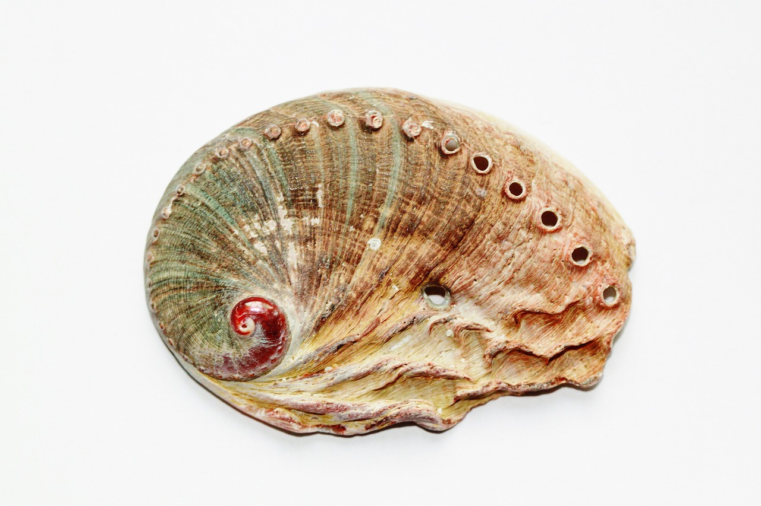
You will need:
The Abalone dataset on Canvas
Sklearn and Matplotlib installed

Slide 4
Course Resources
https://scikit-learn.org/stable/modules/generated/sklearn.cluster.KMeans.html
https://medium.com/@chyun55555/quick-guide-to-k-means-clustering-with-python-example-scikit-learn-6efe8e319893
https://www.learndatasci.com/glossary/hierarchical-clustering/
https://www.geeksforgeeks.org/dbscan-clustering-in-ml-density-based-clustering/

Slide 5
What are clustering algorithms?
Creating groups of related data
Typically an unsupervised learning technique
Helps you find underlying groups, etc
May aid in classification or further analysis
Good investigative technique

Slide 6
Clustering Algorithms
There are many
We are going to look at:
KMeans
Hierarchical Clustering
DBScan

Slide 7
K Means
In this algorithm, you cluster data into K different groups. You set the value for k.
The algorithm is fairly simple (using similar example to: https://medium.com/@chyun55555/quick-guide-to-k-means-clustering-with-python-example-scikit-learn-6efe8e319893)

Slide 8
K Means
Assigns centers of the clusters randomly in space.
Assign each point in the data to the closest cluster
Move the center to the center of all the points associated with it
Repeat until the centers stop moving
(Best explained with a visual)

Slide 9
Data Points

Slide 10
Random Centers

Slide 11
Assign Points to Closest Centers

Slide 12
Move Centers to Middle of Clustered Points

Slide 13
Reassign Points to Closest Center

Slide 14
Repeat Until Center Stops Moving

Slide 15
K Means
Simple, often very useful, fast, and efficient
Quite popular
Works best when data is circular/spherical
Why?
Visualize: https://www.naftaliharris.com/blog/visualizing-k-means-clustering/

Slide 16
This would be hard to classify with K Means

Slide 17
Hierarchical Clustering
Two kinds: Agglomerative and Divisive
Agglomerative starts with every data point in their own cluster and creates new clusters until 1 left
Divisive starts with one cluster and divides clusters until none left
Agglomerative maybe slightly more popular
Basic algorithm is:
Start with data
Merge closest based on metric
Repeat
Illustrate with example, similar to: https://www.learndatasci.com/glossary/hierarchical-clustering/

Slide 18
Data Points – All own clusters

Slide 19
Create merged clusters from close-by points

Slide 20
Repeat

Slide 21
Repeat

Slide 22
Repeat... until only one cluster

Slide 23
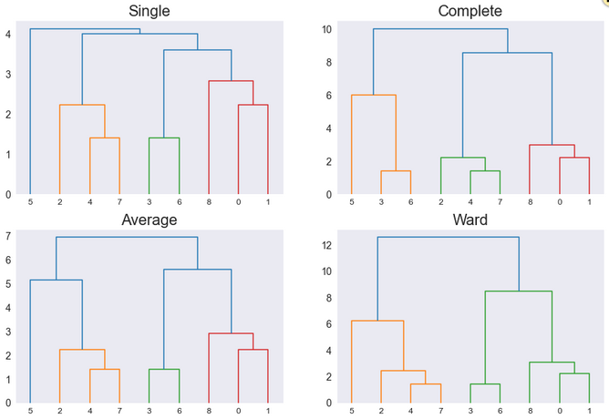
Hierarchical Clustering
Ends up creating a diagram called a dendrogram
From the dendrogram you can sometimes find the distinct clusters
(Different labels refer to different ways to compute cluster distances)
https://www.learndatasci.com/glossary/hierarchical-clustering/

Slide 24
Hierarchical Clustering
Can be more computationally complex
Sometimes more robust to non-spherical cluster data

Slide 25
DBSCAN Algorithm
Uses 2 parameters and 3 types of data points
Source: https://www.geeksforgeeks.org/dbscan-clustering-in-ml-density-based-clustering/

Slide 26
Parameter 1 – eps (epsilon)
Distance metric
If the distance between two points is <= eps, they would be "neighbors"
Source: https://www.geeksforgeeks.org/dbscan-clustering-in-ml-density-based-clustering/

Slide 27
3
4
5
2
Eps = 3

Slide 28
3
4
5
2
Eps = 3, Neighbors in green

Slide 29
Parameter 1- MinPts
Minimum number of neighbors within eps radius
Generally = dimensions + 1
At least 3
Source: https://www.geeksforgeeks.org/dbscan-clustering-in-ml-density-based-clustering/

Slide 30
3
4
5
2
If MinPts = 3, this point doesn't have enough MinPts

Slide 31
Type of Point 1
Core point: A datapoint that has more than MinPts within eps
Source: https://www.geeksforgeeks.org/dbscan-clustering-in-ml-density-based-clustering/

Slide 32
3
4
5
2
If MinPts = 3, not a core point

Slide 33
2
1
1
3
If MinPts = 3, this is a core point

Slide 34
Type of Point 2
Border point: Not a core point (fewer than MinPts within eps) but a neighbor of a core point
Source: https://www.geeksforgeeks.org/dbscan-clustering-in-ml-density-based-clustering/

Slide 35
2
1
1
3
In Red – Border Point. Not a core point, but within a core pt neighborhood

Slide 36
Type of Point 3
Noise/Outlier: Not a core or border point
Source: https://www.geeksforgeeks.org/dbscan-clustering-in-ml-density-based-clustering/

Slide 37
5
6
4
In Green – Outlier/Noise point.

Slide 38
DB Scan
Find all neighbor pts within eps, find core points
For each core point, make a new cluster if not already there
Find density connected points – assign to same cluster as core
Source: https://www.geeksforgeeks.org/dbscan-clustering-in-ml-density-based-clustering/

Slide 39
(Eps and MinPts=3) Find Core Points

Slide 40
Create new cluster for each core point

Slide 41
Each neighbor connected point gets added, broadcasts looking for new members

Slide 42
Each neighbor connected point gets added, broadcasts looking for new members

Slide 43
Repeat until unvisited points are clustered

Slide 44
DB Scan
Don't have to specify a number of clusters
Any shape
But need 2 different params
Source: https://www.geeksforgeeks.org/dbscan-clustering-in-ml-density-based-clustering/

Slide 45
Other Clustering Techniques
https://scikit-learn.org/stable/modules/clustering.html

Slide 46
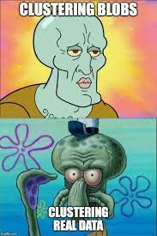
Clustering Datasets
https://github.com/milaan9/Clustering-Datasets
https://www.facebook.com/convolutionalmemes/photos/a.287833355004505/811007336020435/?_rdr

Slide 47
Normalization
Comparing distances on different scales can be tricky
Normalization puts all data on a scale of 0 to 1
Easier to compare across features
Value – minimum / (max – min)

Slide 48
Normalization Example
Doc Cam

Slide 49
Let's Code
Abalone Age
See if we can see distinct groups of abalone
https://www.kaggle.com/datasets/rodolfomendes/abalone-dataset
Nash, W., Sellers, T., Talbot, S., Cawthorn, A., & Ford, W. (1994). Abalone [Dataset]. UCI Machine Learning Repository. https://doi.org/10.24432/C55C7W.

Slide 50
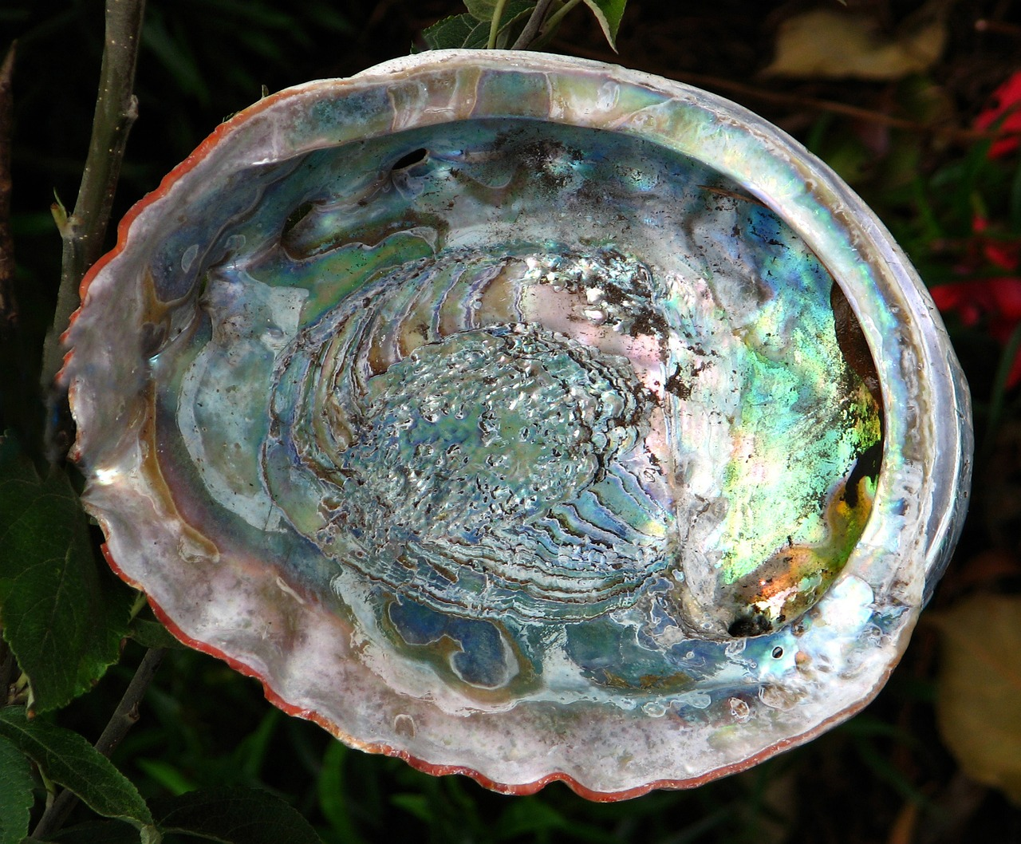
Abalone
Abalones are mollusks
Their meat is valuable for food and shells are valuable for a variety of purposes
Age positively correlated with price

Slide 51
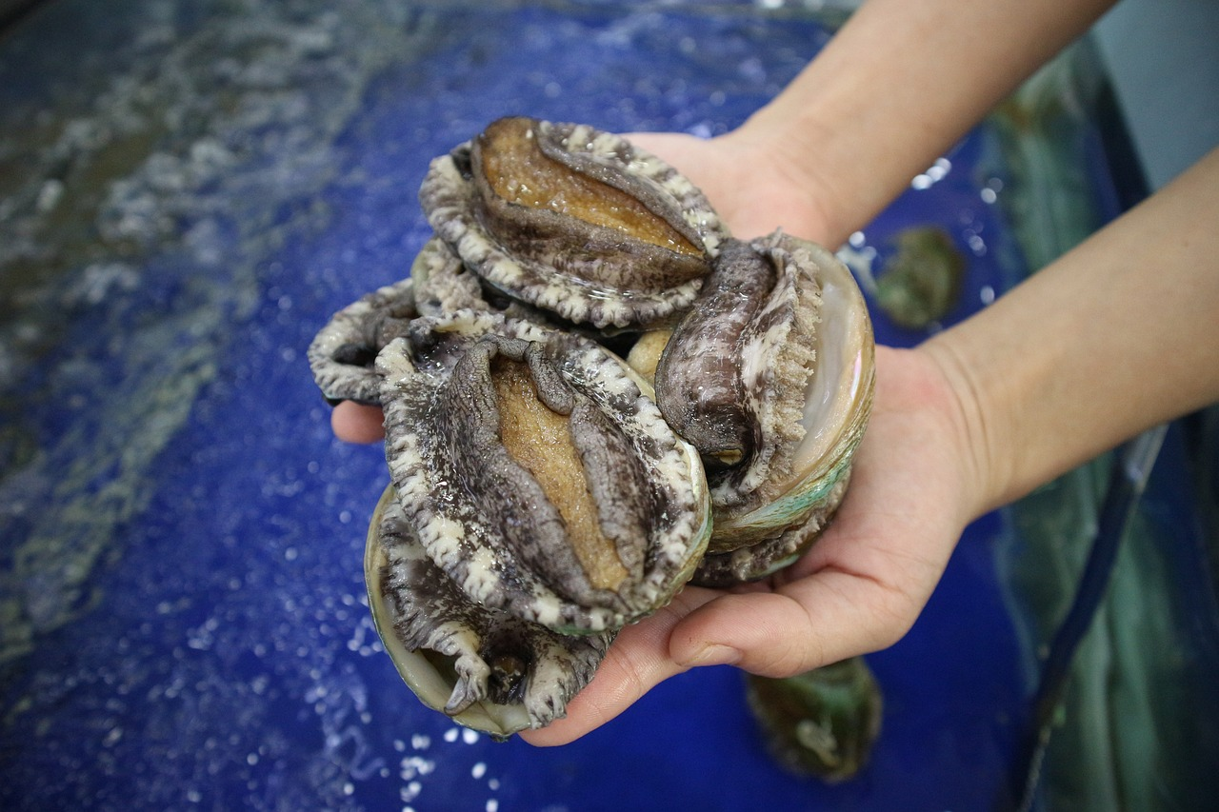
Process for Aging Abalones
Cutting shell through the cone
Staining It
Counting number of rings in microscope
Time consuming
Want to estimate through other means
https://anson.ucdavis.edu/~haochen/abalone_description.pdf

Slide 52
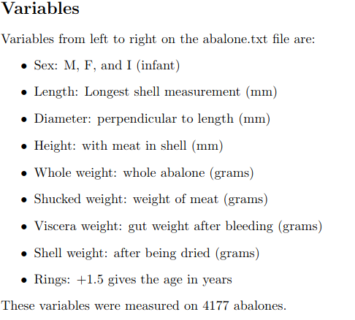
Abalone Dataset
https://anson.ucdavis.edu/~haochen/abalone_description.pdf

Slide 53
Back to Basics
Dataset
Type of Machine Learning
Data Split
Model Evaluation

Slide 54
Back to Basics
Dataset
  Abalones
Type of Machine Learning
Data Split
Model Evaluation

Slide 55
Back to Basics
Dataset
  Abalones
Type of Machine Learning
  Unsupervised
Data Split
Model Evaluation

Slide 56
Back to Basics
Dataset
  Abalones
Type of Machine Learning
  Unsupervised
Data Split
  Probably not needed for this example – would be different with a classifier
Model Evaluation

Slide 57
Back to Basics
Dataset
  Abalones
Type of Machine Learning
  Unsupervised
Data Split
  Probably not needed for this example – would be different with a classifier
Model Evaluation
  Your own intuition
  There are some model metrics you can get

Slide 58
Questions?

